Slide 1

Optimal Machine Learning Techniques to Predict Air Quality Index
GUIDE
Dr. Sumathi
Asst. Professor-III
School of Computing
TEAM
HEMANTH BABU CHAVA 125003105
MANJUNATH P 125003174
PRAVANTH DEVAKI 125003232

Slide 2
Contents of this Presentation
Base Paper
Abstract
Literature Survey
Problem Statement
Objectives
Methodology
Flow diagram of the work
Modules
Work Plan
References

Slide 3
Base Paper
Paper Title: Impact of air pollutants on climate change and prediction of air quality index using machine learning models
Journal Name: Environmental Research Volume 239, Part 1, Article 117354
Year of Publication: 2023
Publisher: Elsevier
Indexing: SCI / Scopus
Paper Link: prediction of air quality index using machine learning models

Slide 4
Abstract
Air pollution demands better monitoring, rising pollution necessitates accurate air quality prediction, crucial for managing environmental quality.
Costly limitations of traditional methods: Manual monitoring stations, though existing, are expensive and limited.
Machine learning emerges as a powerful tool: Ensemble methods will be used to predict AQI using open-source CPCB data.
Scalability and reusability are key: The research seeks a robust ML framework applicable to diverse cities with the CPCB data.

Slide 5
Literature Survey
S.No | Paper Title | Methodology | Merits | Limitations
1 | Air Quality Index prediction using Machine Learning for Ahmedabad City | These are the methods used for the work: SARIMA SVM LSTM | Number of data-preprocessing methods are presented to remove the outliers, normalize the datasets, which are taken from different sources (CPCB boards) Can also be expanded to forecast other pollution indices at different levels. | Lots of missing values are present in the dataset of Ahmedabad city.
2 | Air Quality Index prediction using Machine Learning Algorithms ~International Journal of computer Applications Technology and Research | These are the methods used for the work: ARIMA Auto Regression Linear Regression | Good prediction and Time Series Analysis was also used for recognition of future data points and air pollution prediction | Not able to show expected output as the data is not in sequence The error is high which they are working to overcome in near future.
3 | Indian Air Quality Prediction And Analysis using Machine Learning | The model used for the work is: Naïve forest Linear regression Gradient Boosting Algorithms | Parameter reducing formulations for better performance than standard regression models | Low Accuracy
Notes:
Hi

Slide 6
S.No | Paper Title | Methodology | Merits | Limitations
4 | Air Pollution Prediction Using ML techniques. An approach to replace existing monitoring stations With virtual motoring stations | The model used for the work is: Ridge regression SVR Random Forest Xtreme Gradient Boosting | Hyperparameter tuning developed technique can be transferred to any location where pollutant prediction is required benefit from incorporating other neural networks such as CNN-LSTM (Convolution Neuron Network - Long Short Term Memory) in capturing temporal dependencies and patterns in data | The limitation of this study is that the forecasting of pollutant concentration is not possible as the data from other monitoring stations is required for prediction1
5 | Detection and Prediction of air Pollution using Machine Learning models | The model used for the work is: Logistic regression Auto regression | Mean accuracy and standard deviation accuracy to be 0.998859 and 0.000612 respectively. | No gaseous pollutants were considered Taken very less data
6 | Air Quality prediction by using ML models: a case study on the Indian coastal city Visakhapatnam | The model used for the work is: Random Forest Light GBM Cat Boost Adaptive boosting | Cat Boost model yielded high prediction accuracy (0.9998) and low RMSE (0.76). Cat Boost incorporates parameters that help mitigate overfitting in datasets | Performance needs to be validated under diverse air quality conditions The covid lockdown has affected the AQI levels

Slide 7
Problem Statement
To enhance accuracy in AQI forecasting to facilitate informed decision-making for environmental regulation.
To provide timely warnings and precautions to the public regarding air quality levels.
To Enable proactive measures for mitigating the impact of air pollution on public health.

Slide 8
Objectives
Implement advanced machine learning techniques on CPCB data to enhance accuracy and reliability in AQI prediction.
Evaluate the performance of developed models against existing methods to validate effectiveness.
Demonstrate the potential of the proposed approach to optimize environmental management strategies and safeguard public health against air pollution hazards.

Slide 9
Methodology
We chose Tirupati monitoring station to work with and apply the base paper.
Initially, data is processed to remove noises and handle missing values. Then the data is explored for patterns and a comprehensive analysis is made using apt tools like correlation matrix.
Data is transformed and standardized before fitting it to the model for training and testing.
To ensure the robustness of the models, we used 5-fold cross-validation, computed MAE, MSE, RMSE, and R2 scores for each fold, and reported the mean and standard deviation of each metric across all folds. When a model has a higher R2 score and lower MAE and MSE scores, it is generally regarded as performing better
Models and methods - Random Forest, XGBoost, Bagging Regressor, LGBM Regressor
Python libraries and modules - numpy, pandas, seaborn, sklearn.model_selection, GridSearchCV

Slide 10
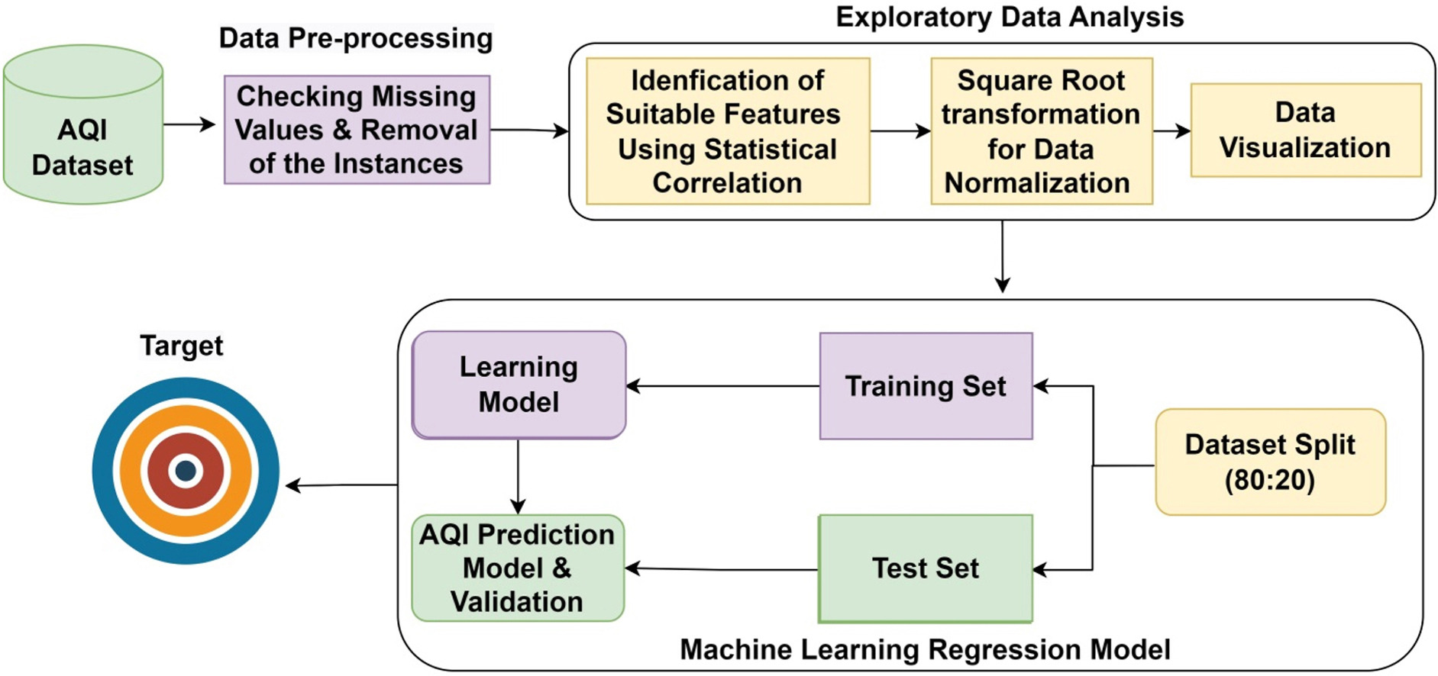
System Architecture/Flow diagram of the work

Slide 11
Dataset
1. Source: Central Pollution Control Board (CPCB), India
2. Content: Continuous ambient air quality measurements
3. Parameters: PM2.5, PM10, NO, NO2, NOx, NH3, CO, SO2, Benzene, Toluene, Ozone, RH, Xylene, BP,AT, RF, Temp, SR
4. Time period: From 01-01-2017 to 31-12-2022
5. Location: Tirumala, Tirupati, Andhra Pradesh, India
6. Data format: A comma-separated value (CSV) file
7. Potential uses: The dataset can be used to train machine learning models to predict air quality index (AQI), analyze air quality trends, and assess the impact of air pollution on public health.
Dataset : Central Control Room for Air Quality Management - All India

Slide 12
Modules
Module 1: Data Preprocessing, Exploratory Data Analysis, Data transformation
Module 2: Data spilt and fitting the models
Module 3: Comparative Analysis, Performance valuation, Result and Discussion

Slide 13
Module 1 – Data Preprocessing
The datasets were obtained from the Central Pollution Control Board’s - Central Control Room for Air (CPCB-CRR). They include measurements of air pollutants and meteorological parameters.
Raw dataset contained a total of 2191 observations spanning from 01-01-2017 to 31-12-2022, which included 20 variables ( 13 Air pollutant attributes, 06 Meterological factors, and 1 AQI )
Removed rows of instances with null values for the target variable ( AQI ) and BP (Barometric Pressure) parameter was removed since it had only 47 instances of recorded data and not helpful.
Handling Missing Values: Used forward fill (previous day values) for null and ‘None’ values

Slide 14
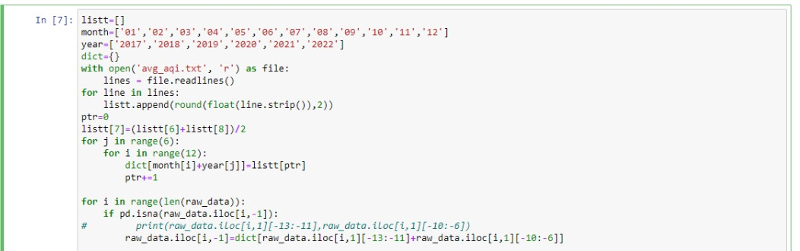
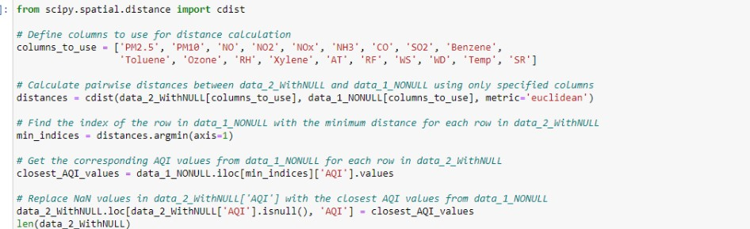
Module 1 – Data Preprocessing
Trying imputation and matching patterns for 240 rows of missing target variable values
Filling the average value of the missing row’s month
Choosing the value of row with closest parameter values wrt Euclidean dist.

Slide 15
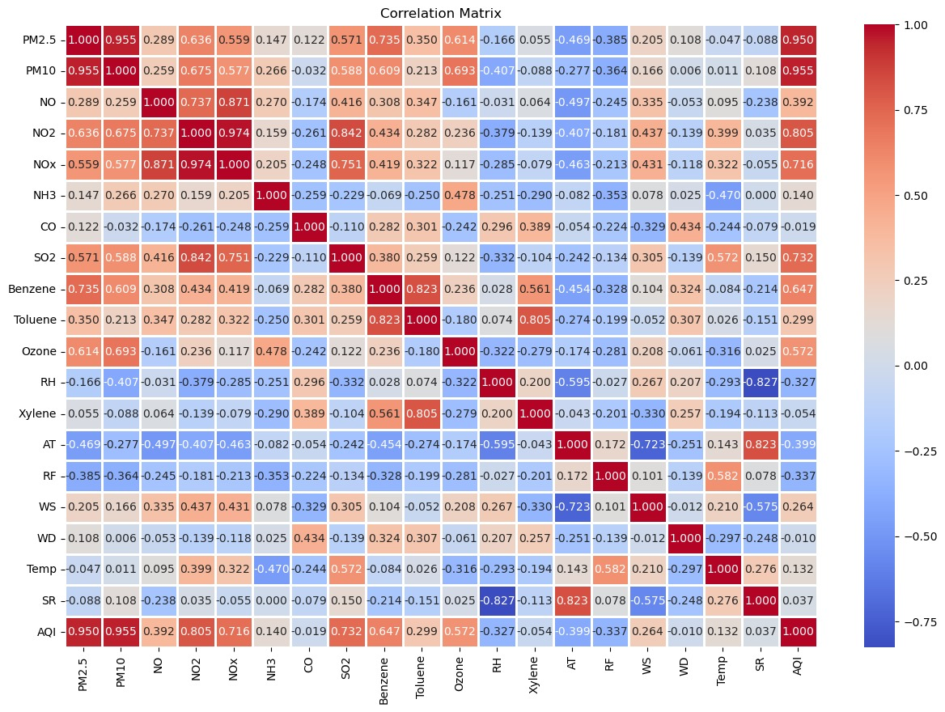
Module 1 – EDA
The pollutants with the highest heat map values had a significant impact on AQI predictions
When compared to the negative or inversion correlation, the positive correlation plays a major role in AQI prediction.
With a correlation coefficient of 0.95, the highest among all parameters, the relationship between PM10 and AQI is significant, indicating that PM10 and PM2.5 plays a crucial role in determining the AQI.
NOTE: We also tried to remove the parameters with threshold value of 0.15, yet found no improvement in accuracy
Heat Map – Input parameters with AQI

Slide 16
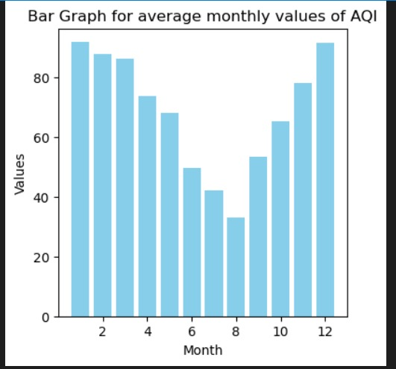
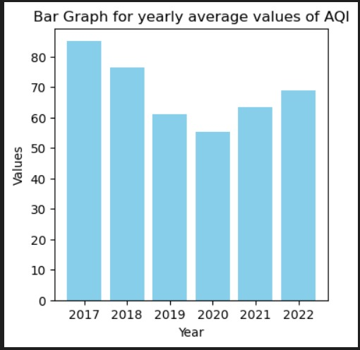
Module 1 – EDA
The results show that AQI levels were extremely high in Dec and Jan. Seasonal variation may be the reason for the highest level of AQI in these months. These months fall under the winter season when temperatures are lower and more mist formation is observed. Because of the presence of moist air in the atmosphere, this could result in the formation of a temperature inversion and the pollutants emitted from the source get retained in the atmosphere.
Seasonal and annual variation of AQI

Slide 17
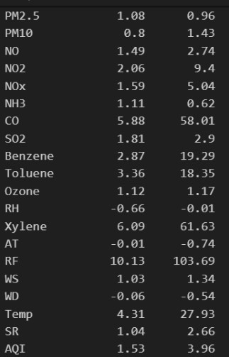
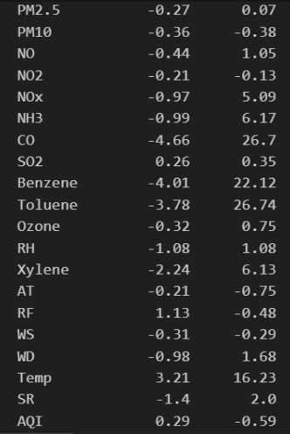
Module 1 – Data Transformation
Before transformation
After transformation
The most commonly used data transformation techniques are Box-Cox transformation, log transformation and square root transformation.
Log transformation is a powerful tool to reduce skewness in data. It works by compressing larger values and spreading out smaller ones.
Log transformation was used to change the data to make it more normal.
Skew
Kurtosis
Skew
Kurtosis

Slide 18
Module 2 – Model Development:
Data Split (80:20) and Standardization
We assign the target variable AQI to the variable y and all other features except AQI to the variable X as explanatory variables.
X_train Y_train
Input parameters : X Out parameters : Y
X_test Y_test
We utilize the sklearn.model_selection module to split the data into two distinct sets: training and testing, using the train_test_split() function. The dataset is split into 80% for training and 20% for testing.
An inadequately selected split can lead to the model being overfit or underfit, which can result in inadequate predictions on unseen data. Therefore, it is crucial to select the split carefully and assess the model’s performance on the test data to ensure that it can generalize well to new data.
To normalize the features of the training and testing sets, we use the StandardScaler() function from the sklearn

Slide 19
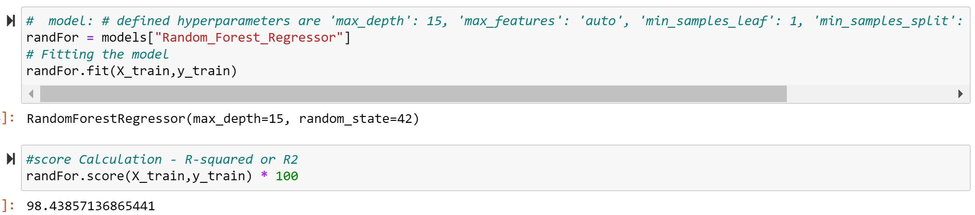
Module 2 – RandomForest
Random forest regression employs a collection of decision trees trained on random feature subsets and data instances.
Implemented via scikit-learn, we use classes like RandomForestRegressor for model creation and k-fold for cross-validation.
The RandomForestRegressor object is initialized with preset hyperparameters: max_depth of 15, max_features set to 'auto', min_samples_leaf at 1, min_samples_split of 2, and n_estimators of 100, alongside a designated random_state.

Slide 20
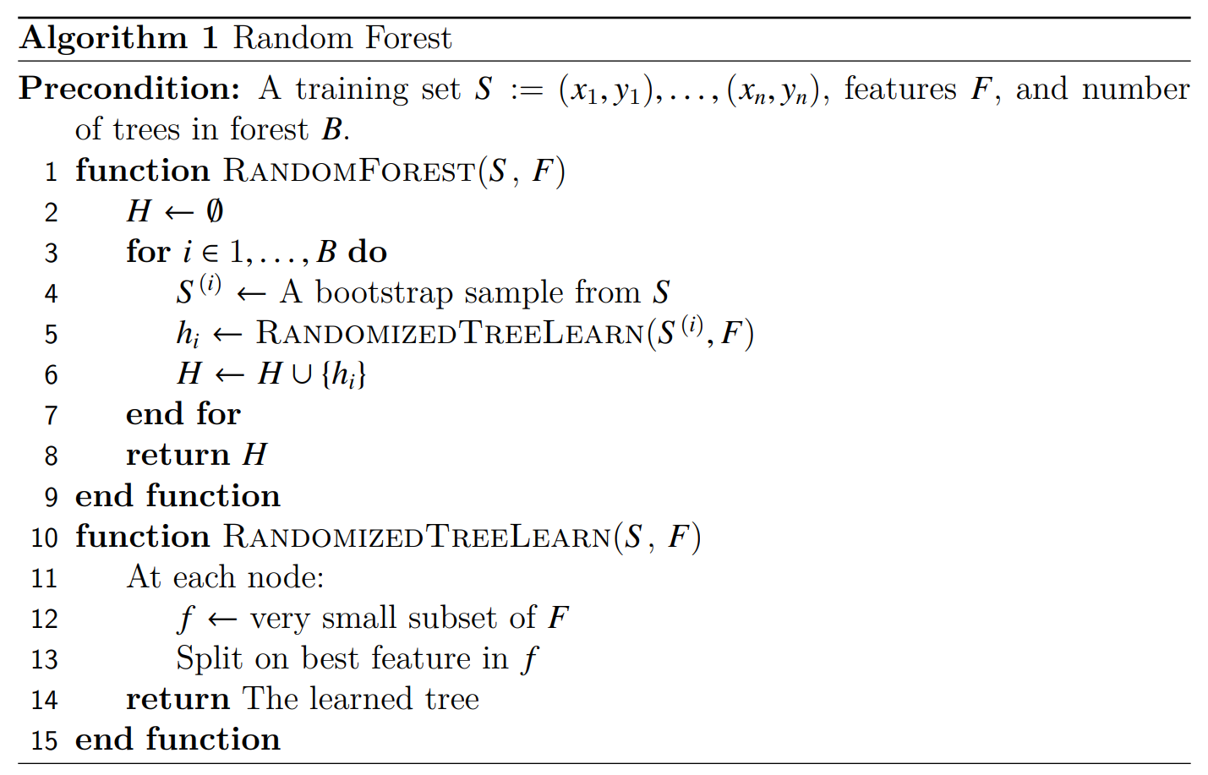
Module 2–RandomForest algorithm
The random forest algorithm uses the bagging technique for building an ensemble of decision trees. Bagging is known to reduce the variance of the algorithm.
For each tree in the forest, we select a bootstrap sample from S where S(i) denotes the ith bootstrap. We then learn a decision-tree using a modified decision-tree learning algorithm.
At each node of the tree, we randomly select some subset of the features f ⊆ F, where F is the set of features. The node then splits on the best feature in f rather than F. In practice f is much, much smaller than F. By narrowing the set of features, we drastically speed up the learning of the tree.

Slide 21
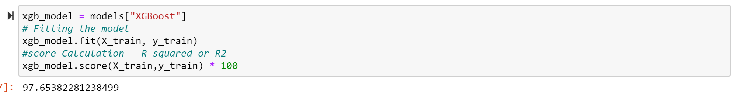
Module 2 – XGBoost
XGBoost ( Extreme Gradient Boosting ) is an ensemble method that builds a strong model by training weak learners sequentially on weighted versions of the dataset.
Implemented via the XGBRegressor class from XGBoost and employed GridSearchCV and k-fold classes from scikit-learn for hyperparameter tuning and cross-validation respectively.
After training, the best hyperparameters were determined to be ‘learning_rate’: 0.1, ‘max_depth’: 5, and ’n_estimators’: 100. These optimized settings allowed the XGBoost model to achieve its highest performance when predicting the AQI.

Slide 22
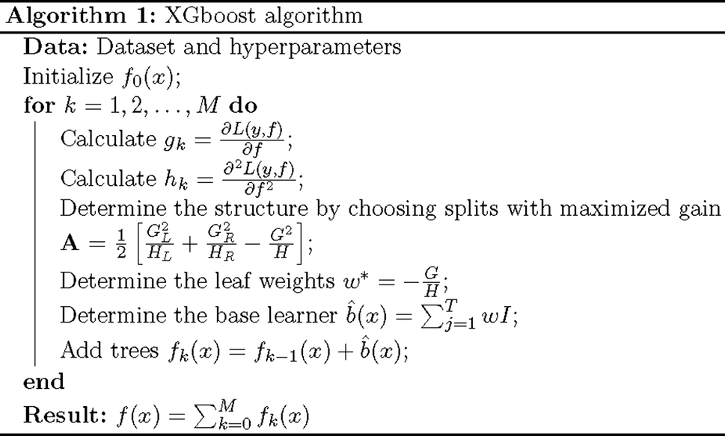
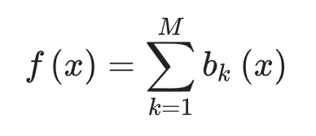
Module 2–XGBoost algorithm
XGBoost is based on the principle of gradient boosting, which is an ensemble learning technique where weak learners (usually decision trees) are trained sequentially, with each tree learning from the errors of its predecessors.
Let b_{k}(x) be a function, which is often addressed as a base learner. The additive model is thus the sum of base learners:
for k = 1, 2, … M where M is the number of base learners.

Slide 23
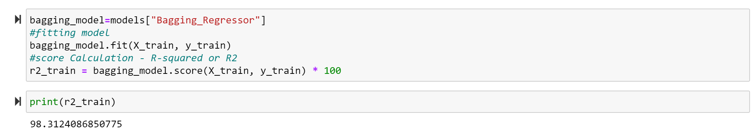
Module 2 – Bagging Regressor
Bagging regressor, short for Bootstrap Aggregating regressor, is an ensemble learning technique where multiple regression models are trained on random subsets of the training data with replacement, and their predictions are aggregated to improve overall prediction accuracy and reduce overfitting.
Import the necessary classes from the scikit-learn library, including the Bagging Regressor class, and Kfold classes and GridSearchCV for cross-validation and hyperparameter tuning respectively.
The best hyperparameters are found to be ‘n_estimators’: 300 and ’max_samples’: 0.9 .Finally, the bagging regression model is used to predict the target variable on the test set, and its efficacy is assessed.

Slide 24
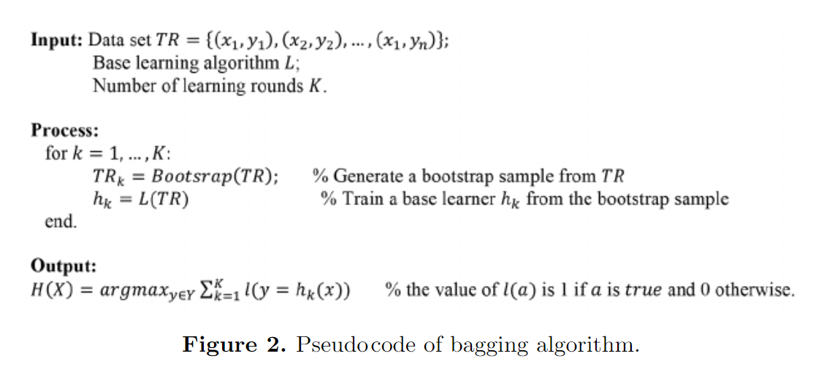
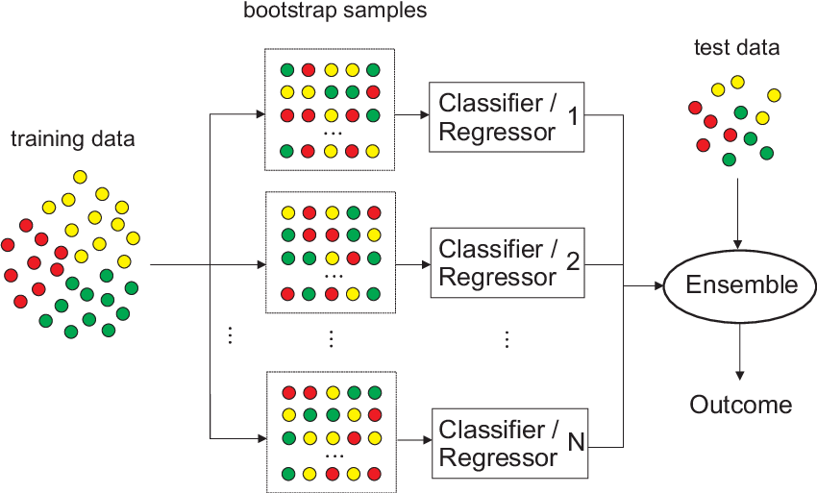
Module 2–Bagging Regressor algo
A Bagging Regressor works by training multiple base regressors on different subsets of the training data and averaging their predictions to improve accuracy and robustness. It reduces variance, improves generalization, and enhances robustness by combining the predictions of individual models.

Slide 25
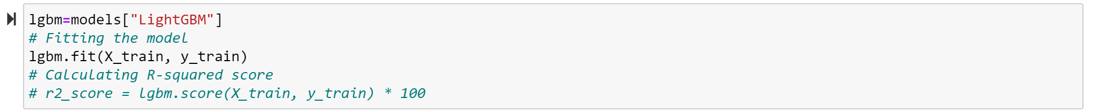
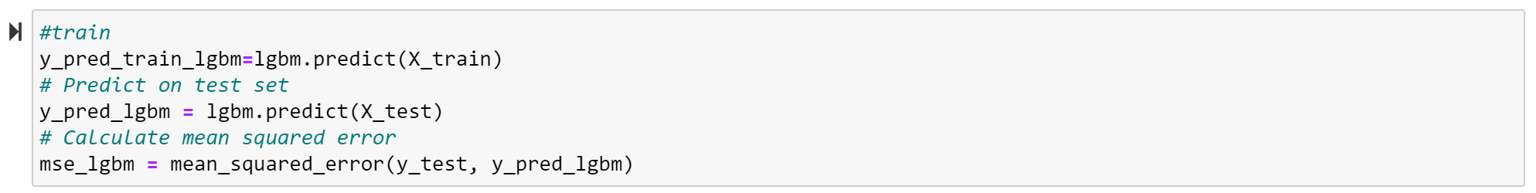
Module 2 – LightGBM Regressor
LGBM Regressor stands for LightGBM Regressor, which is a gradient boosting framework that uses tree-based learning algorithms. It's designed to be efficient and scalable, particularly for large datasets.
LightGBM supports L1 and L2 regularization, allowing for better control of model complexity and preventing overfitting. From LightGBM library, we import the necessary LGBMRegressor class.
Finally, we use the best hyper parameters found by the grid search (i.e., ‘learning_rate’: 0.1, ‘max_depth’: 7, ‘n_estimators’: 50, ‘num_leaves’: 31) to create the final model.

Slide 26
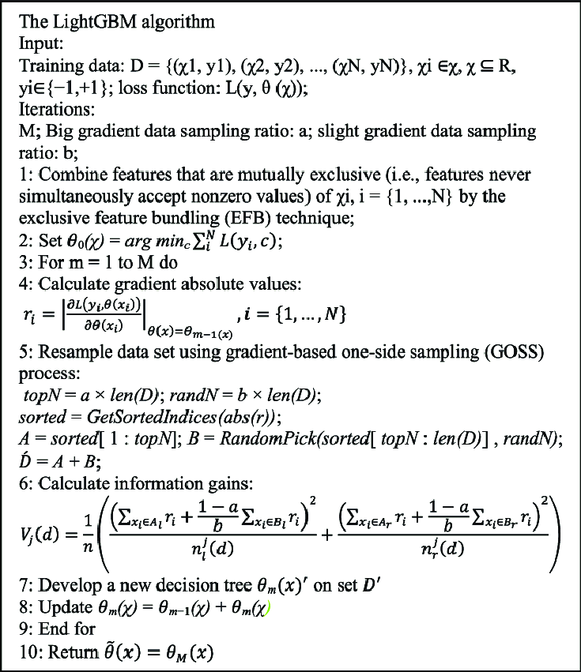
Module 2–LGBM Regressor algo
LightGBM algorithm can bundle unique features into a single bundle; then, the feature-scanning algorithm can be considered for creating same-feature histograms based on the feature bundles
The computation complexity was calculated based on theoretical time complexity as follows: computation complexity =(n∗m), where m denotes the number of data set samples, and m denotes the number of bundles that is less than the number of features in the data set.
LightGBM uses the gradient-based one side sampling (GOSS) method to preserve the accuracy of the information gain estimation; GOSS retains instances with large gradients (e.g., larger than a predeﬁned threshold or those among the top percentiles) and randomly samples those instances with small gradients

Slide 27
Module 3
Comparative analysis on performance of the ensemble methods and implemented models.
AQI predictions made using machine learning models
Normal distribution of datasets, Residual plots, Residual Histograms of different predictive models
Comparison of performance by different ML models in Training and Validation/Testing and novelty
Result discussion and Conclusion

Slide 28
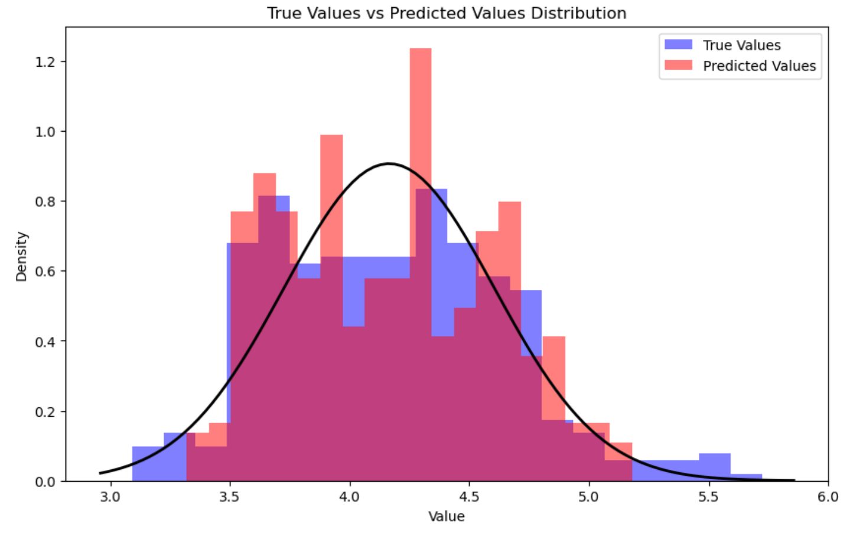
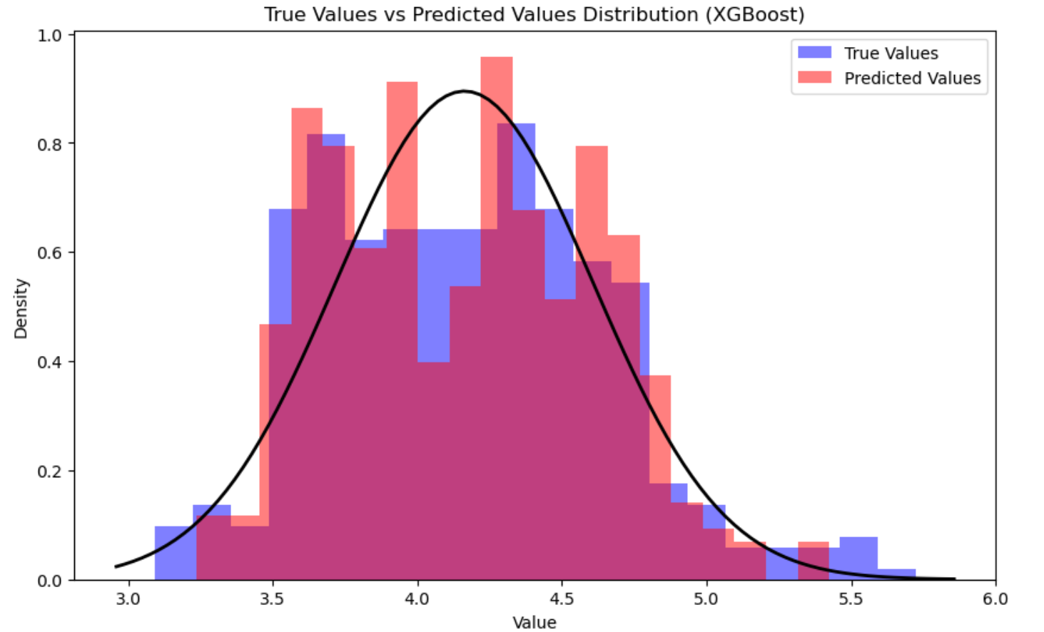
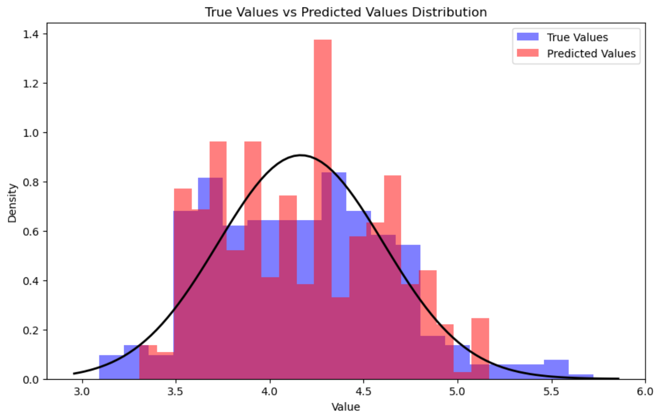
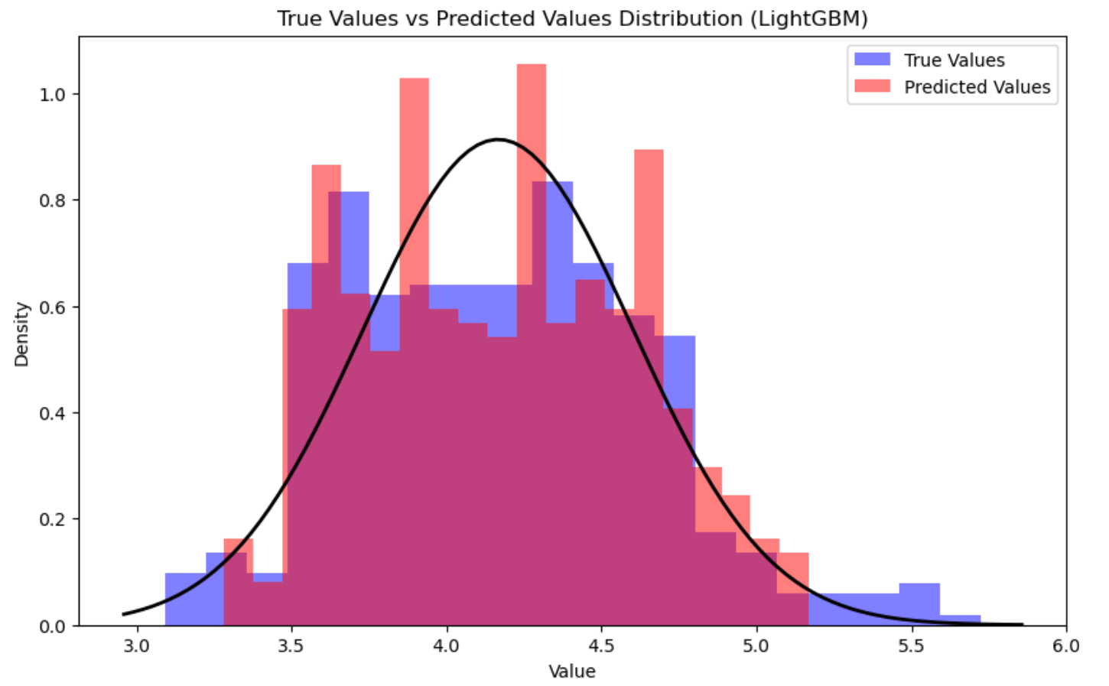
Module 3– Density vs Residuals
Random Forest
XGBoost
Bagging Regressor
LGBM Regressor

Slide 29
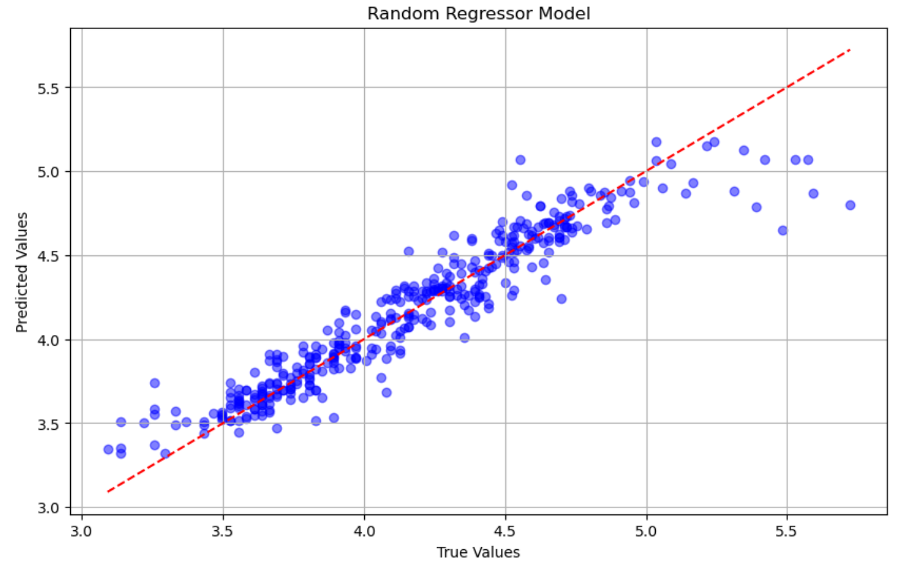
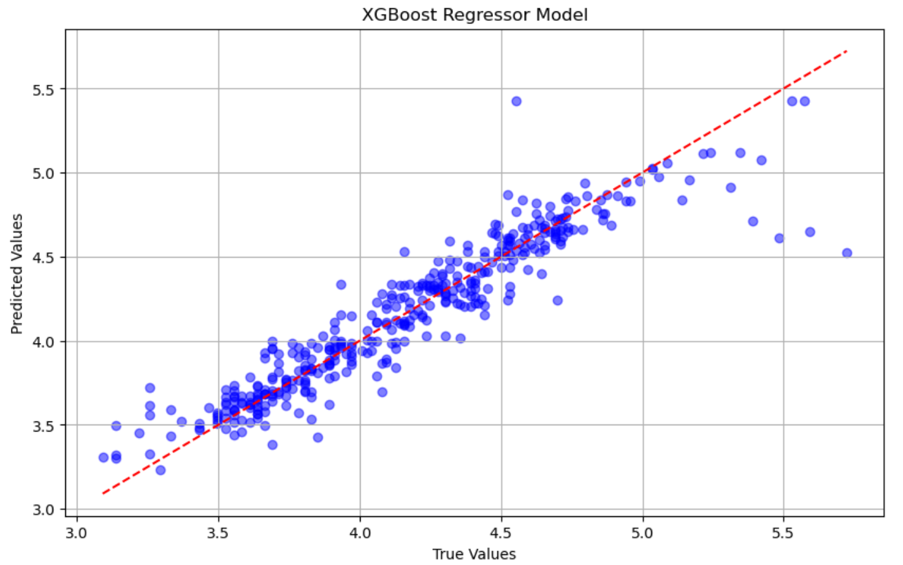
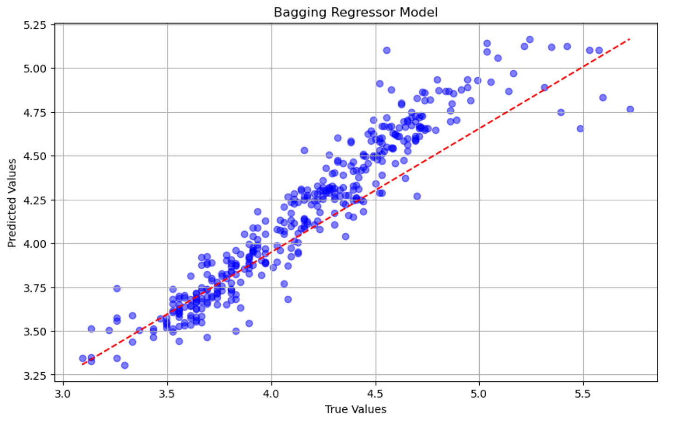
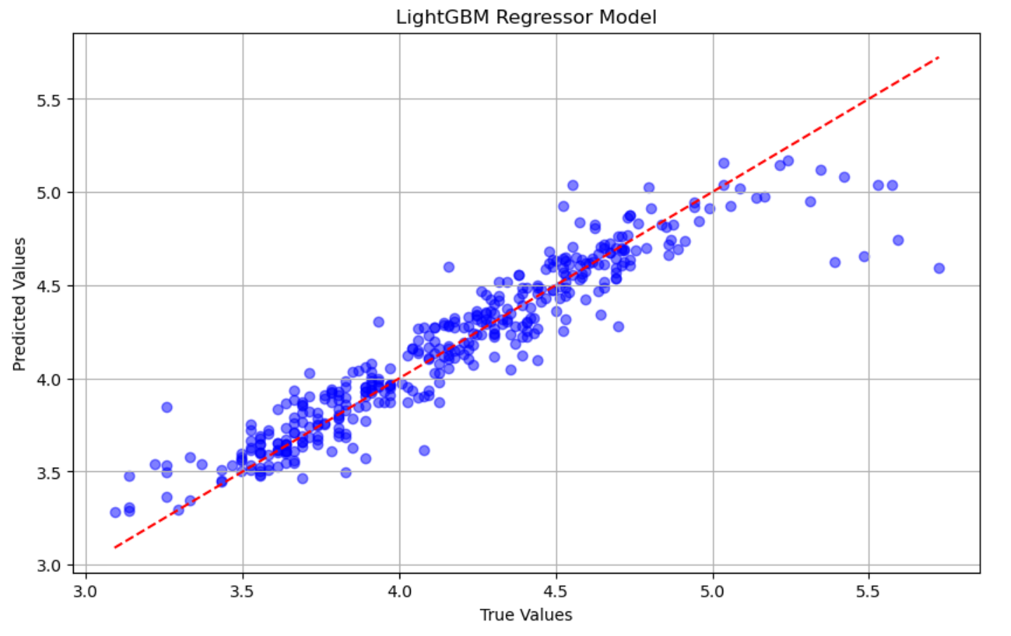
Module 3– True vs Predicted values
Random Forest
XGBoost
Bagging Regressor
LGBM Regressor

Slide 30
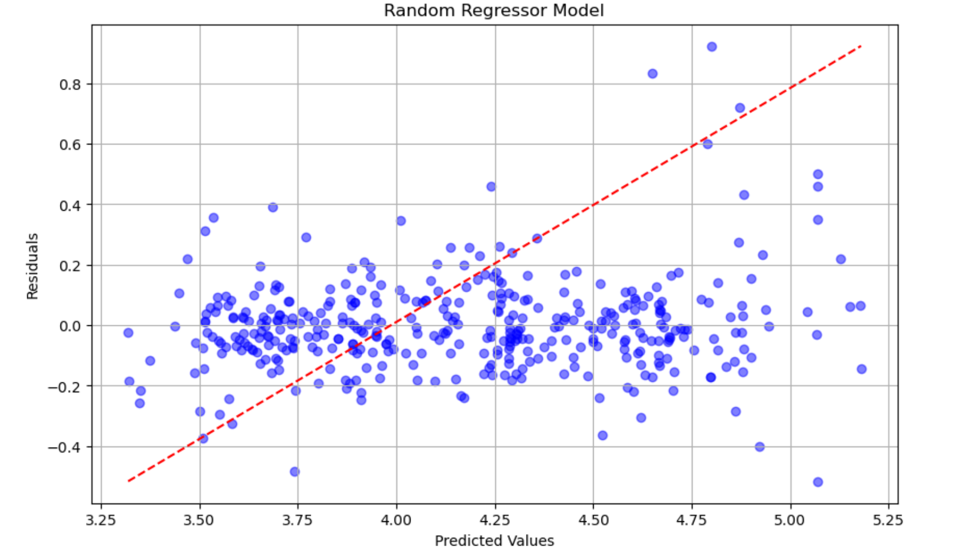
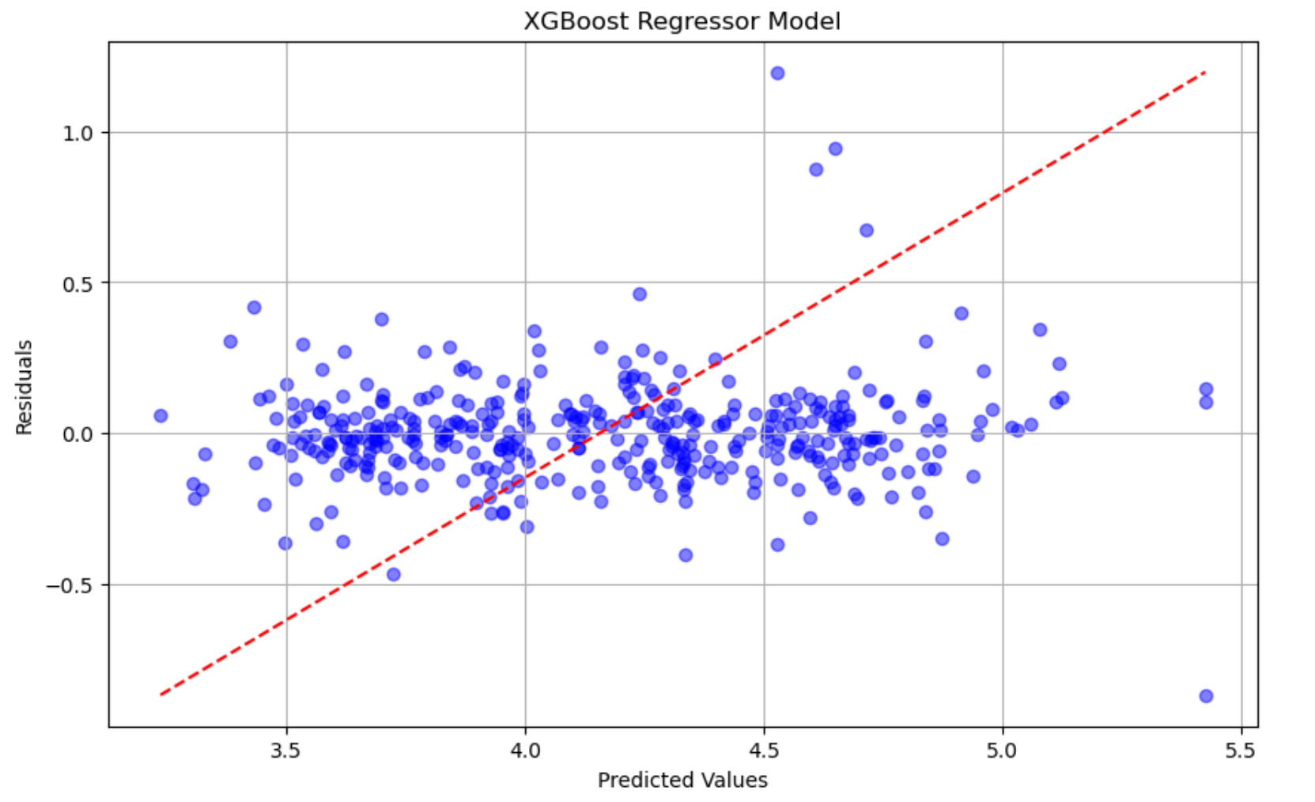
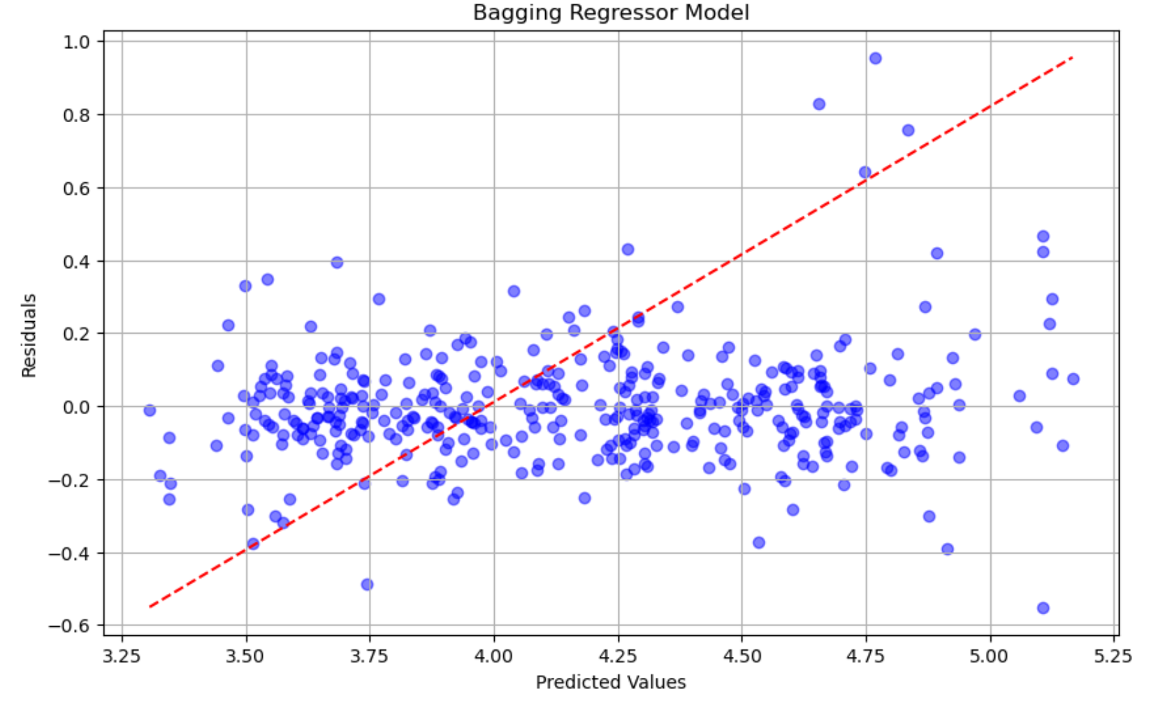
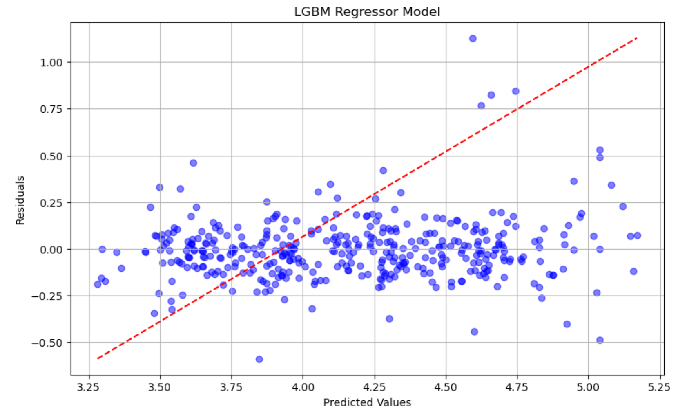
Module 3– Predicted vs Residuals
Random Forest
XGBoost
Bagging Regressor
LGBM Regressor

Slide 31
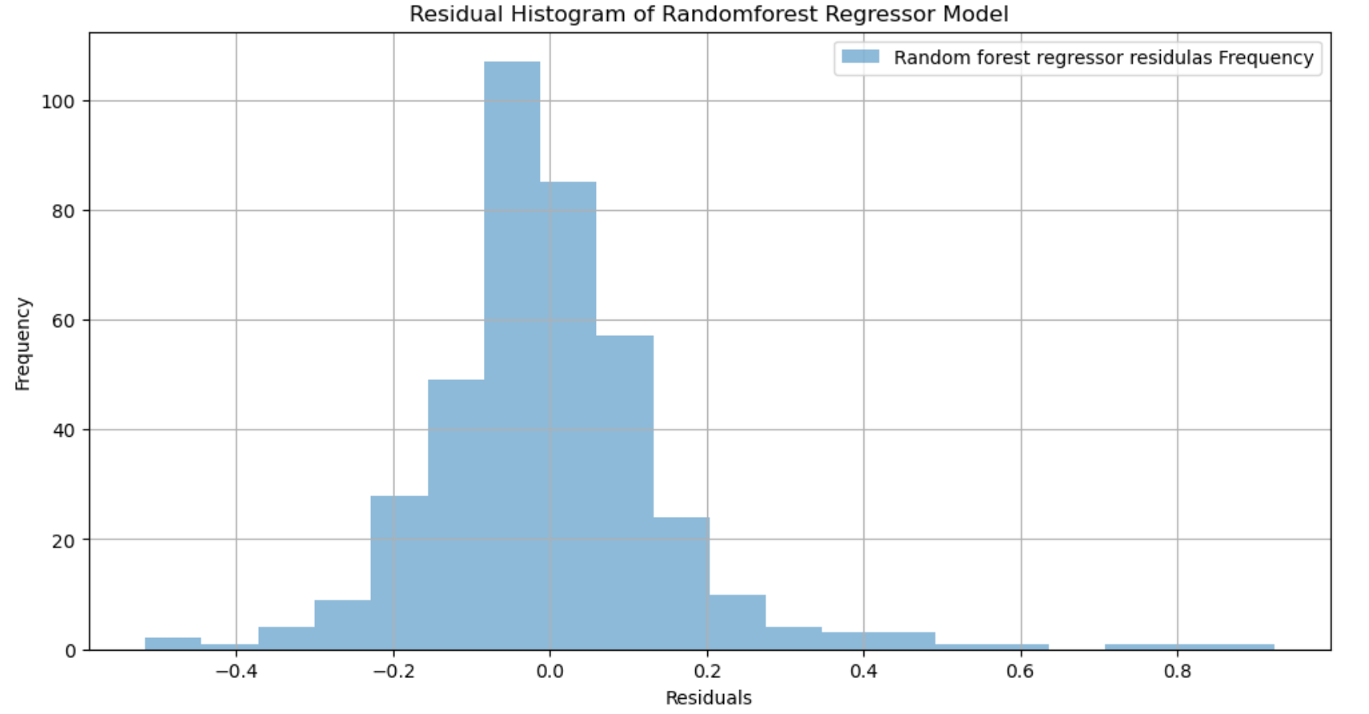
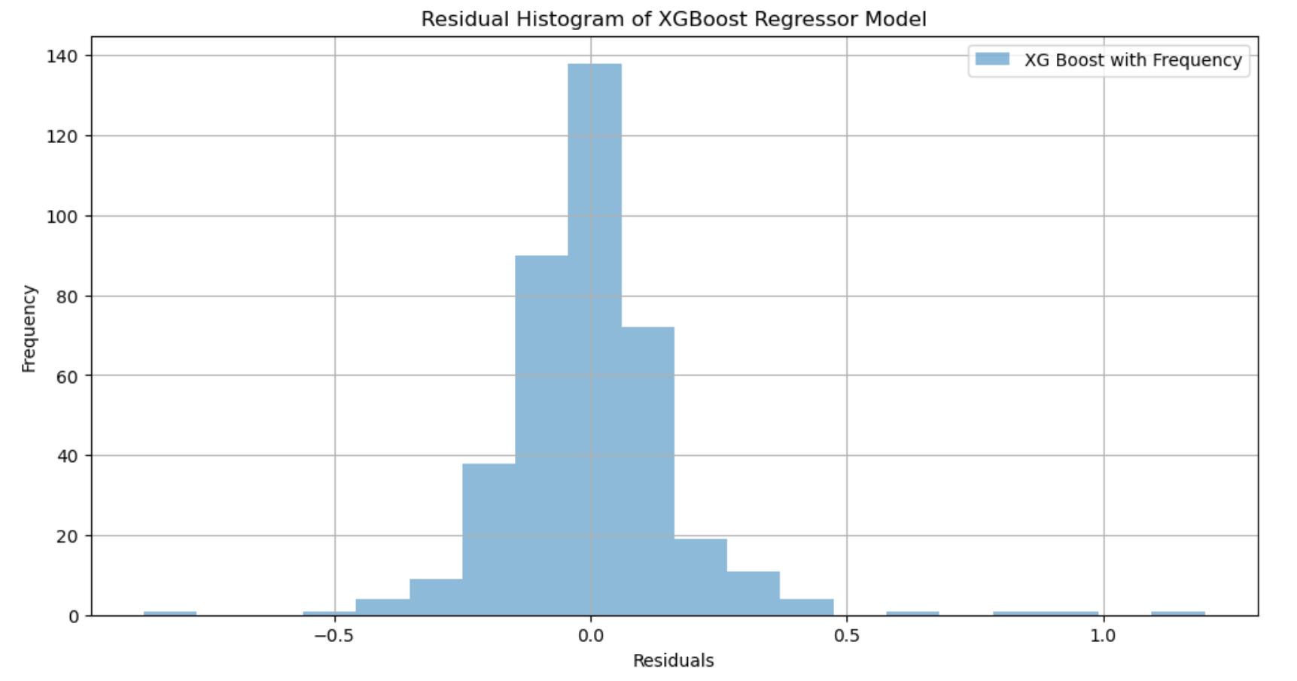
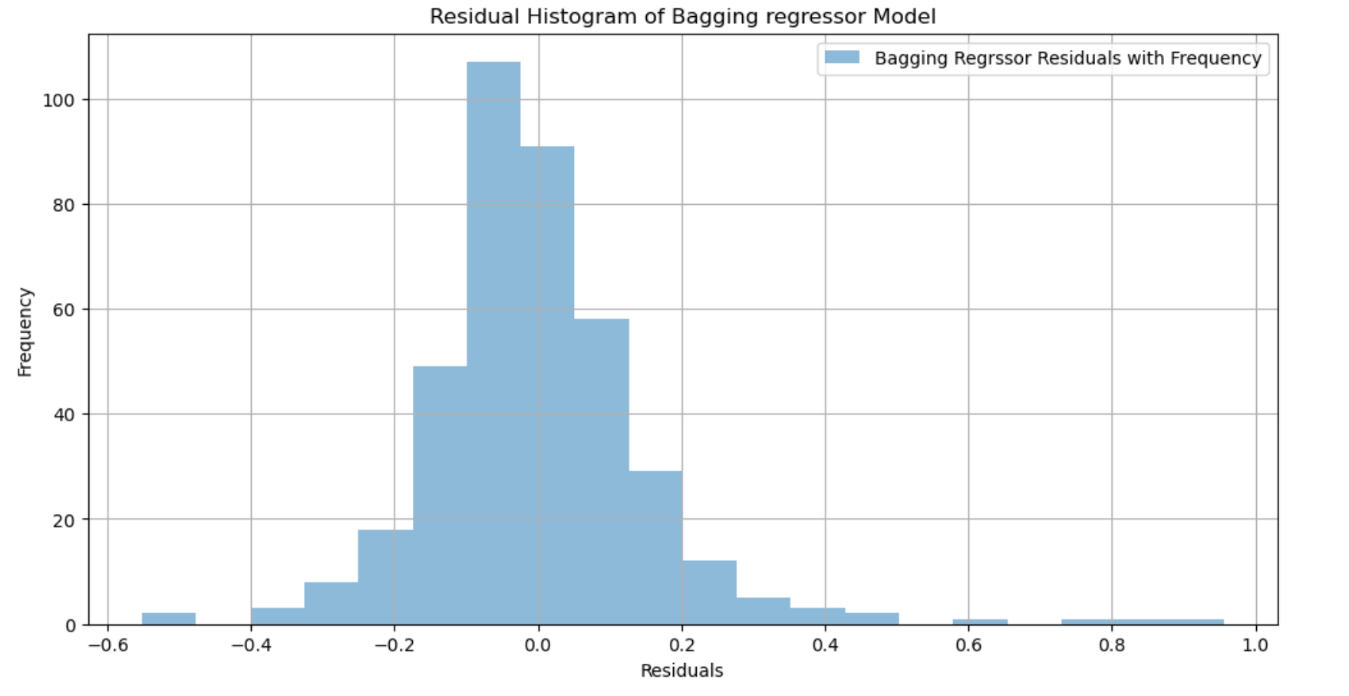
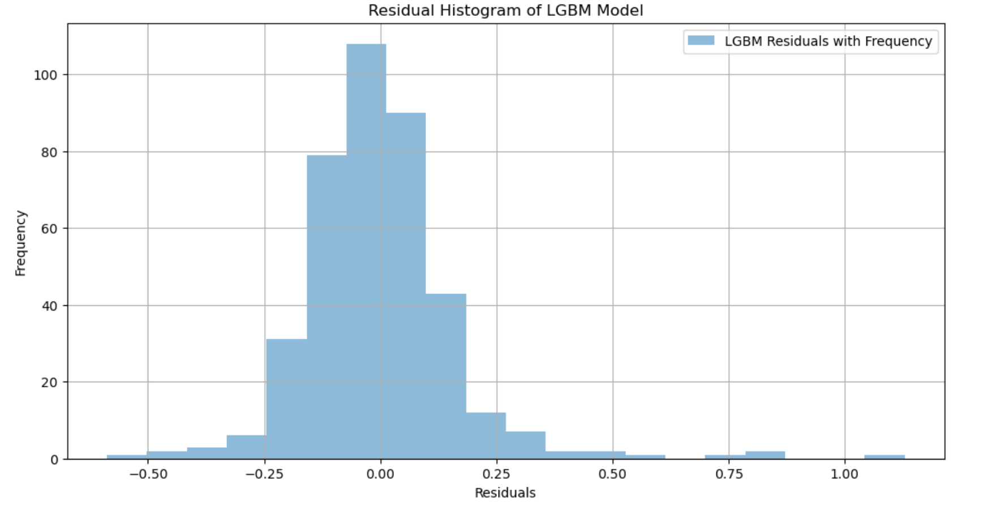
Module 3– Residual Histograms
Random Forest
XGBoost
Bagging Regressor
LGBM Regressor

Slide 32
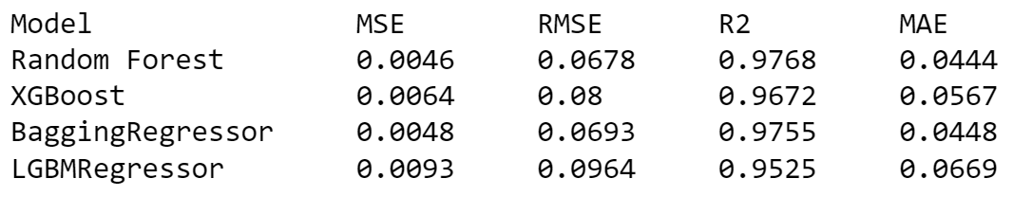
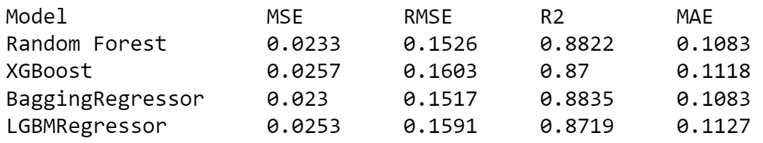
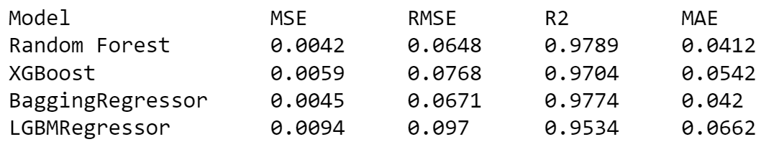
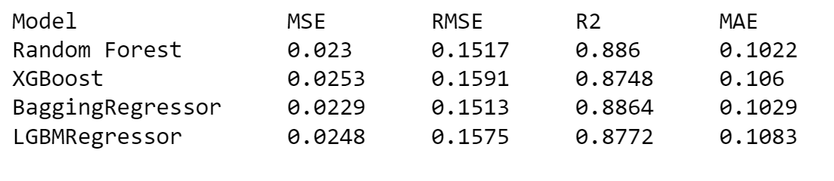
Module 3– Comparative Analysis
Performance of different ML models wrt Monthly Average data preprocessing
Training Data
Testing Data
Performance of different ML models wrt Closest row value data preprocessing
Training Data
Testing Data

Slide 33
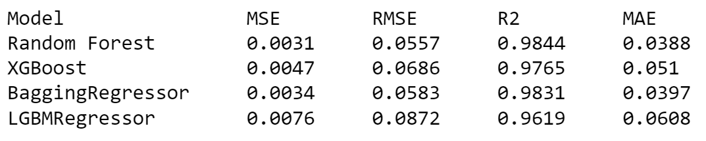
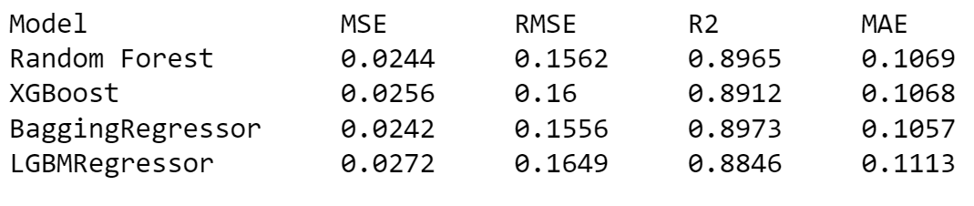
Module 3– Comparative Analysis
Performance of different ML models on Removal of rows with no target variable values
Training Data
Testing Data
On comparing the above three sets of values, we conclude that the ML models scored high when the rows without target variable values are removed.
The highest among them being for Random Forest (0.9844) , for training data

Slide 34
Module 3– Result & Inferences
The current project explored the historical AQI dataset of Tirupati City from 2017 to 2022
The parameters like PM2.5 and PM10 played significant role in AQI prediction, which huge correlation
Three different approaches were possible when rows with missing target variable values were either removed or replaced with imputation/closest row value
After fitting the ML models ( Random Forest, XGBoost, Bagging Regressor, LightGBM ), the approach of removing the missing rows turned out to produce high scores of accuracy
The ML models Random Forest and Bagging Regressor showed maximum correlation of 0.9844 and 0.9831 respectively for the training data. The Bagging Regressor score is 0.8973 for testing/validation
Thus with the help of ML algorithms, AQI can be accurately predicted and used as virtual air monitoring stations. This project showcased the optimal ML models in case of Tirupati City AQI prediction.

Slide 35
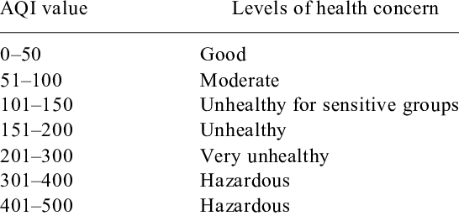
Module 3– Conclusion
The performance scores of different ML models are compared against and the it seems that Random Forest and Bagging Regressor perform better in case of AQI predictions in general.
All the standard codes and procedures were followed.
The AQI values of a particular region can be accurately predicted for any day and pollutant concentrations.

Slide 36
WORK PLAN
Review Period | Work Particulars | % of Work Completed
Zeroth Review | Base paper Confirmation Problem identification Literature Review | -
First Review | System architecture design Module identification Proposed Algorithm implementation | 40%
Second Review | Proposed algorithm implementation Comparative Analysis Providing security features | 100%

Slide 37
References
Gokulan Ravindiran, Sivarethinamohan Rajamanickam, Karthick Kanagarathinam, Gasim Hayder, Gorti Janardhan, Priya Arunkumar, Sivakumar Arunachalam, Abeer A. AlObaid, Ismail Warad, Senthil Kumar Muniasamy: “ Impact of air pollutants on climate change and prediction of air quality index using machine learning models” ,Environmental Research, Volume 239, Part 1, 2023, 117354
Gokulan Ravindiran, Gasim Hayder, Karthick Kanagarathinam, Avinash Alagumalai, Christian Sonne,” Air quality prediction by machine learning models: A predictive study on the indian coastal city of Visakhapatnam”, Chemosphere, Volume 338, 2023, 139518.
C R, Aditya & Deshmukh, Chandana & K, Nayana & Gandhi, Praveen & astu, Vidyav. (2018).” Detection and Prediction of Air Pollution using Machine Learning Models”. International Journal of Engineering Trends and Technology. 59. 204-207.
A. Samad, S. Garuda, U. Vogt, B. Yang, “Air pollution prediction using machine learning techniques – An approach to replace existing monitoring stations with virtual monitoring stations”, Atmospheric Environment, Volume 310, 2023, 119987
Nilesh N. Maltare, Safvan Vahora, “Air Quality Index prediction using machine learning for Ahmedabad city”, Digital Chemical Engineering, Volume 7, 2023, 100093

Slide 38
Thank you

